Slide 1
The ArcGis
The ArcGis

Slide 2
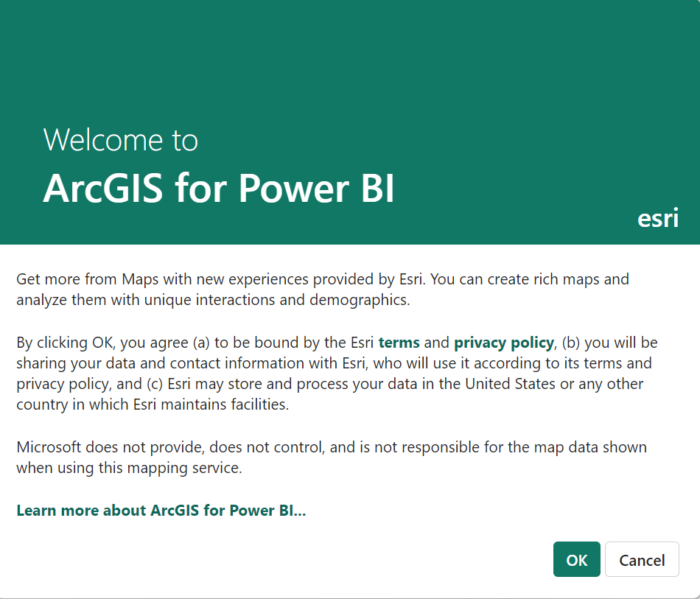
The ArcGis
Note: To complete this lab you must be connected to the internet and have an account at http://www.arcgis.com
You must create a 21-day trial account
Or sign in with a Microsoft account

Slide 3
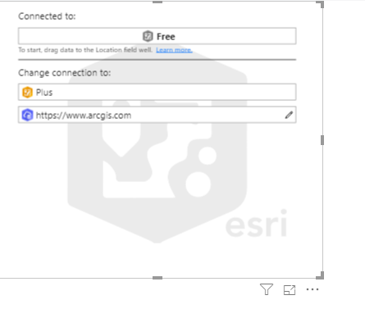
The ArcGis
Click OK in the dialog box.

Slide 4
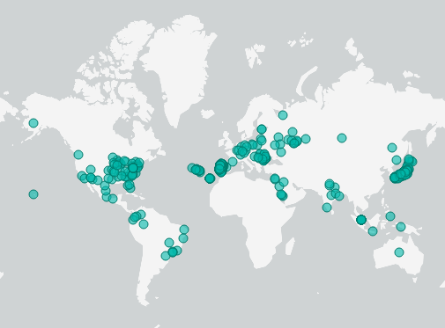
The ArcGis
Click Edit just at the bottom right at the More Options menu
Enter the connection settings and observe what happens
Then enter the Location field at the Location parameter level

Slide 5
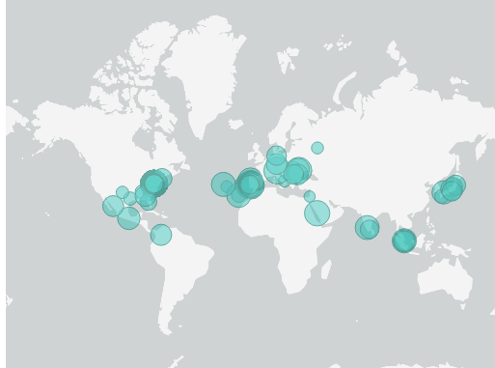
The ArcGis
At the Size parameter enter the average value of the profit and observe the change
Add the City field to the Tootip parameter

Slide 6
Thank you
Thank you

